Slide 1

Welcome to Back to School Night!
Mrs. Flanagan
August 30, 2022

Slide 2
Agenda
About Mrs. Flanagan
Goals
Curriculum
Grading
Conferences
SEL
MTSS
Specials
Communication
Extras
Questions

Slide 3
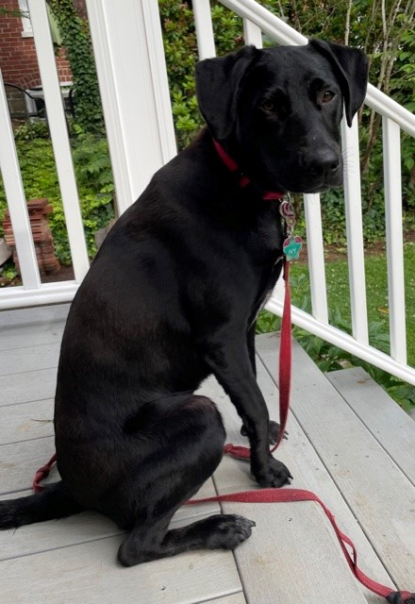
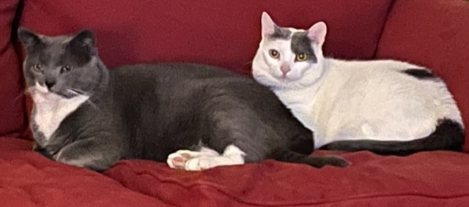
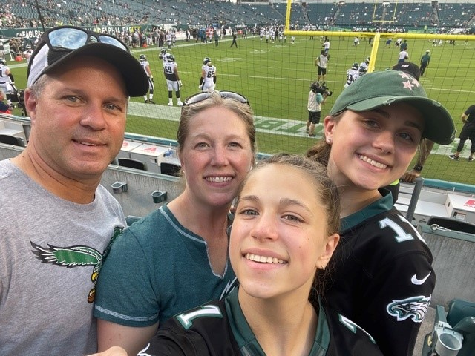
About Mrs. Flanagan
Bachelor of Science in Elementary Education and Early Childhood, Kutztown University
Master’s Degree in Elementary Education, Wilkes University
24th year in CBSD, 2nd, 4th ,and 3rd grades
2 years in the School District of Philadelphia, K-5
2 daughters, live in North Wales

Slide 4

Goals
Safe, happy, respectful people
Confident, reflective, life-long learners
Responsible and organized
Build classroom community
Work together to achieve these

Slide 5


Curriculum: Reading and Writing

Slide 6
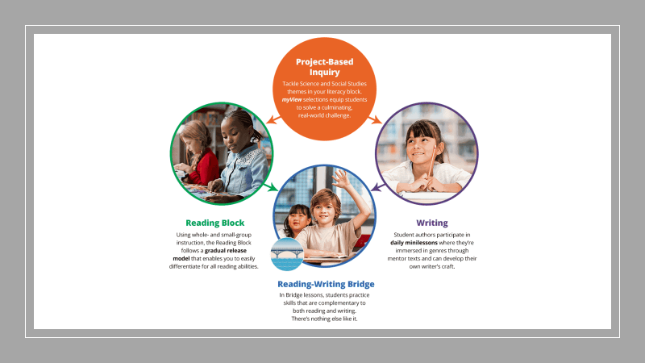

Slide 7
My View/ My Perspective
Provides comprehensive, explicit instruction grounded in the Science of Reading.
Allows for the teaching of Reading and Writing with a rich underpinning of research and rigor, as it inspires creativity.
Engages all students with authentic and high interest literature and resources.
Supports all students with differentiated resources.

Slide 8
Curriculum: Math
  Calendar Math
  Fact Fluency
  Math In Focus
    Trimester 1: Numbers to 10,000, Addition and Subtraction within 10,000, Multiplication Tables
    Trimester 2: Multiplication Tables, Multiplication, Bar Models, The Four Operations, Fractions, Measurement, Area & Perimeter
    Trimester 3: Area & Perimeter, Graphs & Line Plots, Time, Angles, Lines & 2D figures

Slide 9

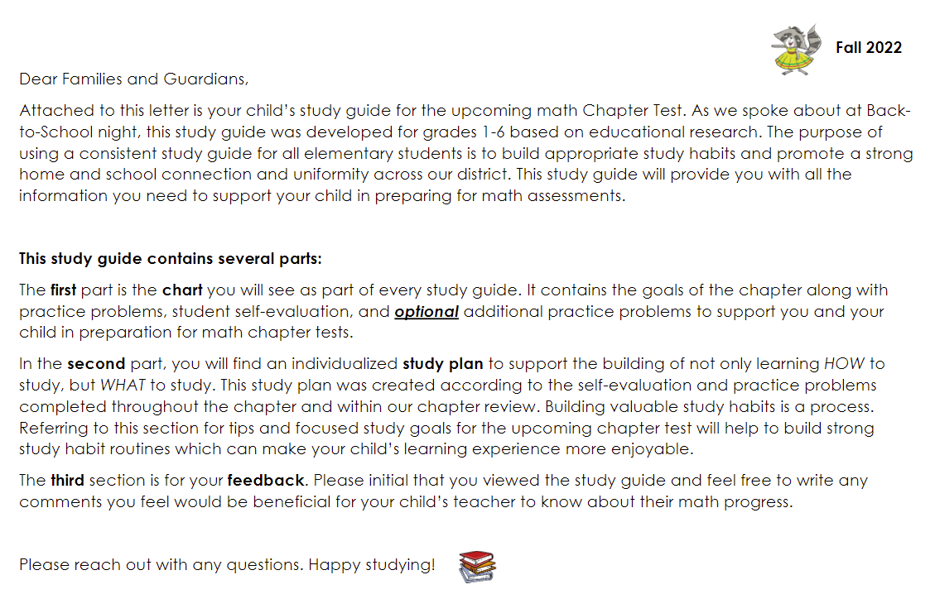
Elementary Mathematics Chapter Study Guides

Slide 10
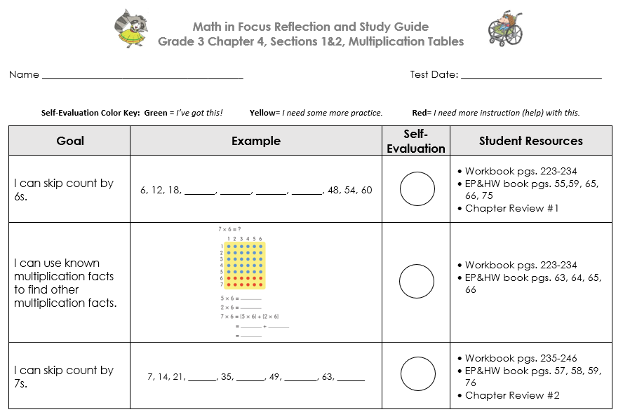
Elementary Mathematics Chapter Study Guides

Slide 11
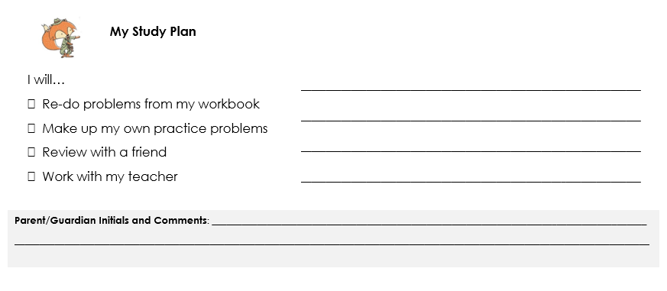
Elementary Mathematics Chapter Study Guides

Slide 12
Curriculum: Social Studies & Science
  Social Studies
    TCI
    People in Our Community, Geography, Economics, Being An Active Member of Our Community
  Science
    Science Companion
    Life Cycles, Solar System, Motion

Slide 13

Grading
Online Standards-based reporting system
3 Trimesters, 3 report cards: December, March, June
Success Standards: 3 (consistently), 2 (often), 1 (rarely)
Learning Standards: Reading, Writing, Math, Soc. St., Science:
+ (exceeding), M (meeting), / (approaching), - (limited progress)
Assessments
  Math In Focus unit tests, My View unit assessments, oral reading, reading responses, writing pieces, science/social studies unit tests
Study guides provided, in-class reviews

Slide 14
Conferences
December 12-13
(Early Dismissal Days)
March 27-28
(early dismissal days)

Slide 15

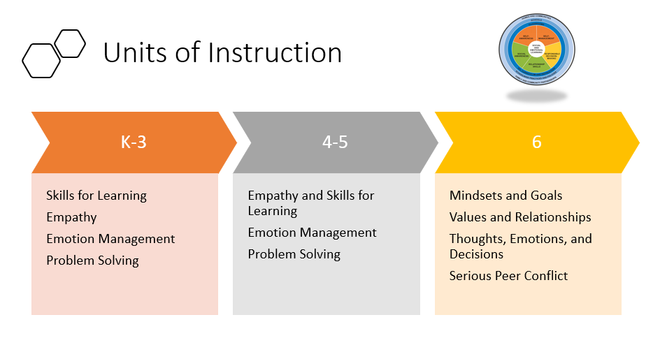
SEL: Social Emotional Learning

Slide 16
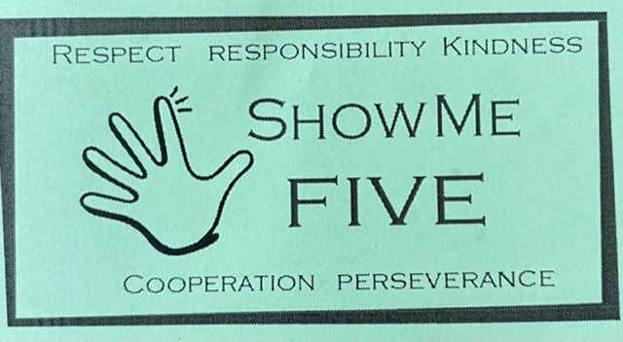
Gayman’s Code of Conduct
Respect, Responsibility, Kindness, Cooperation, Perseverance
Classroom, hallways, playground, APR, bus
Show Me 5 tickets, Stop and Think Form

Slide 17


MTSS: Multi Tiered System of Support In The Elementary School

Slide 18
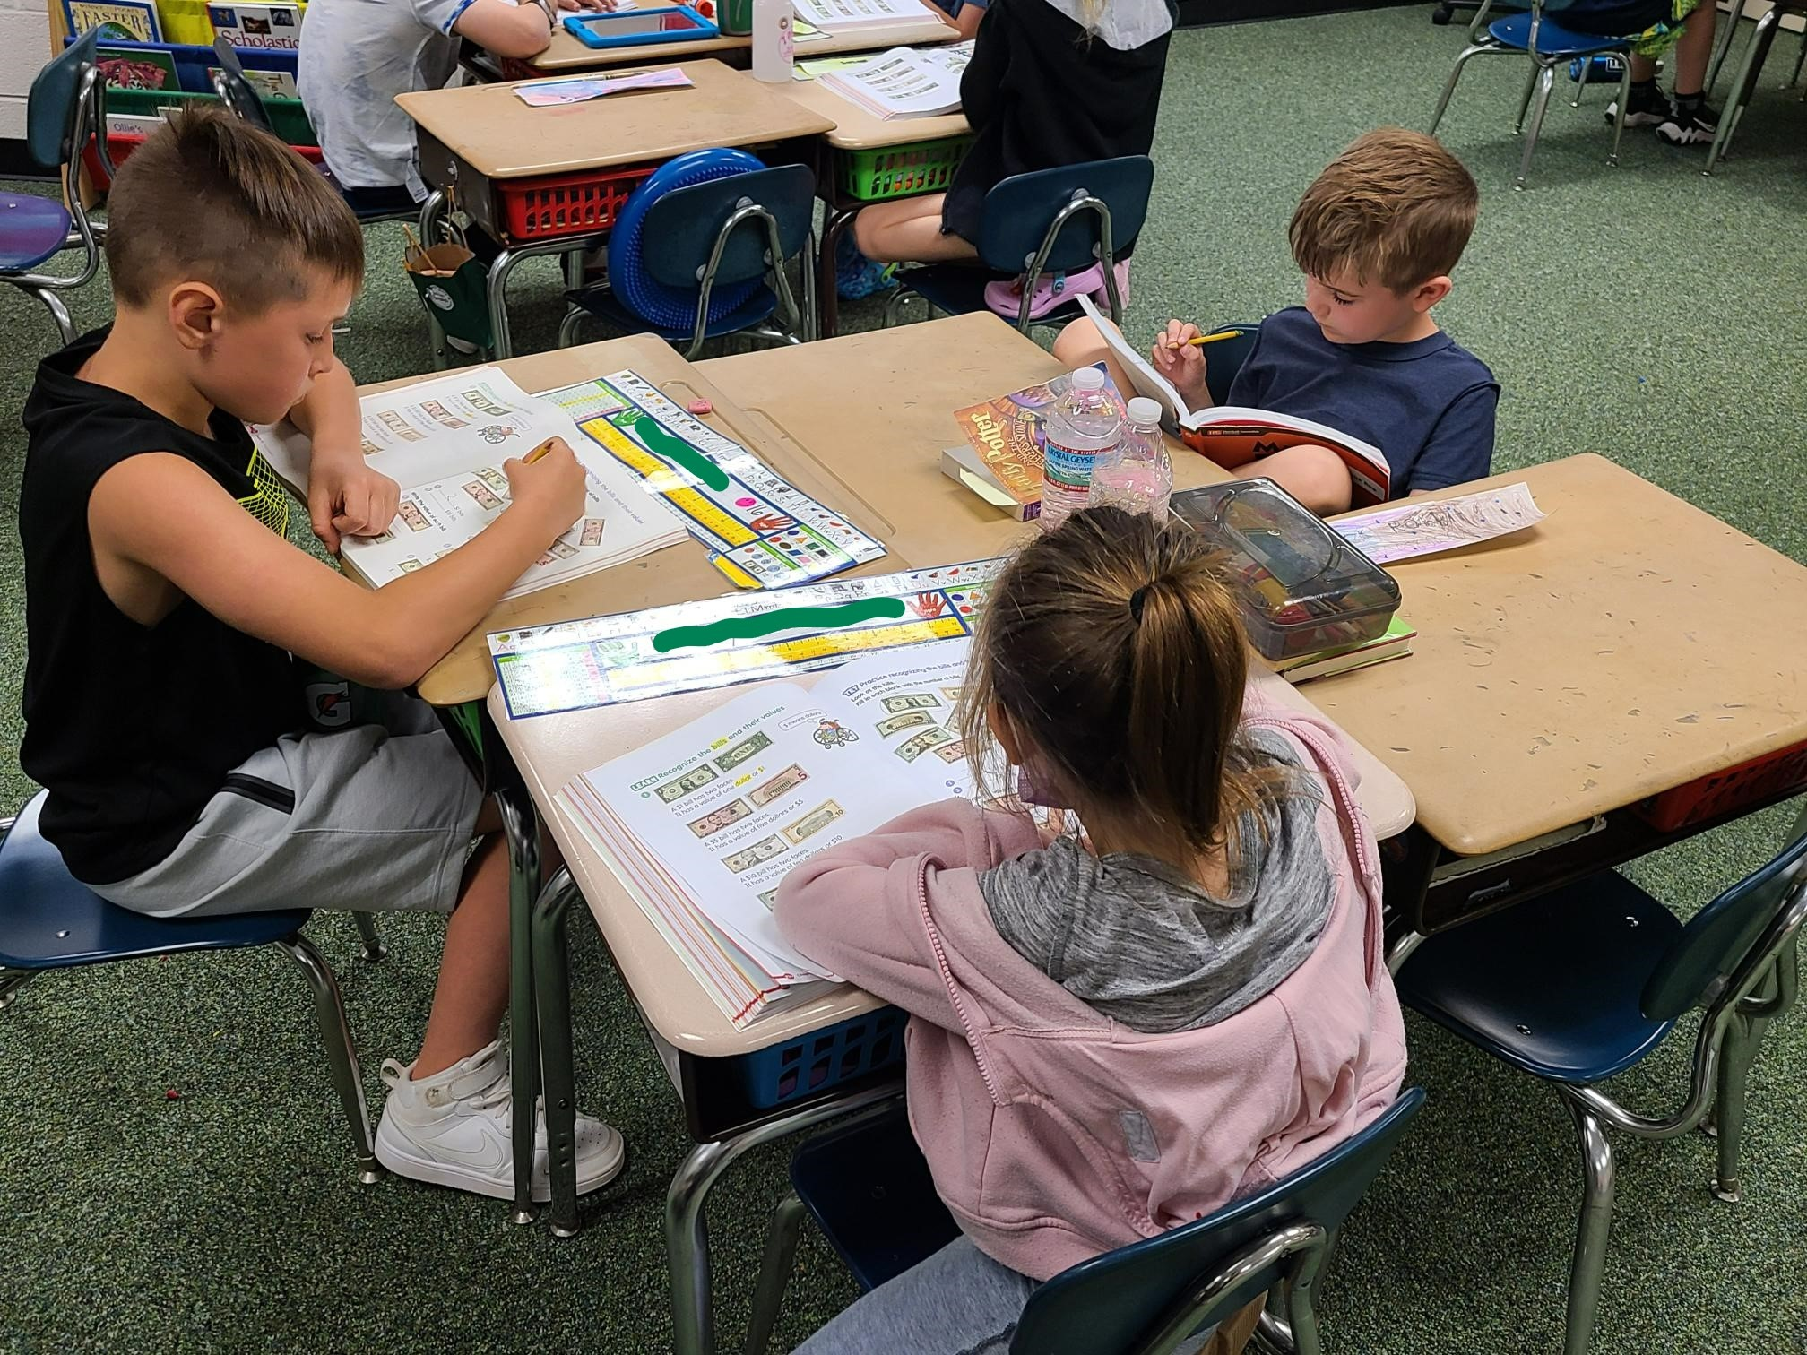
Background
MTSS is a comprehensive school improvement framework, driven by the problem-solving process, focusing on core instruction and meeting students’ needs.
Our goal is to improve performance by assessing all students, identifying specific needs early and modifying instruction quickly using evidence-based practices.
During our team meetings, reading and math data is analyzed and discussed. This data is one point which, along with other measures, is used to inform our core instruction and make focused decisions for individual students.

Slide 19
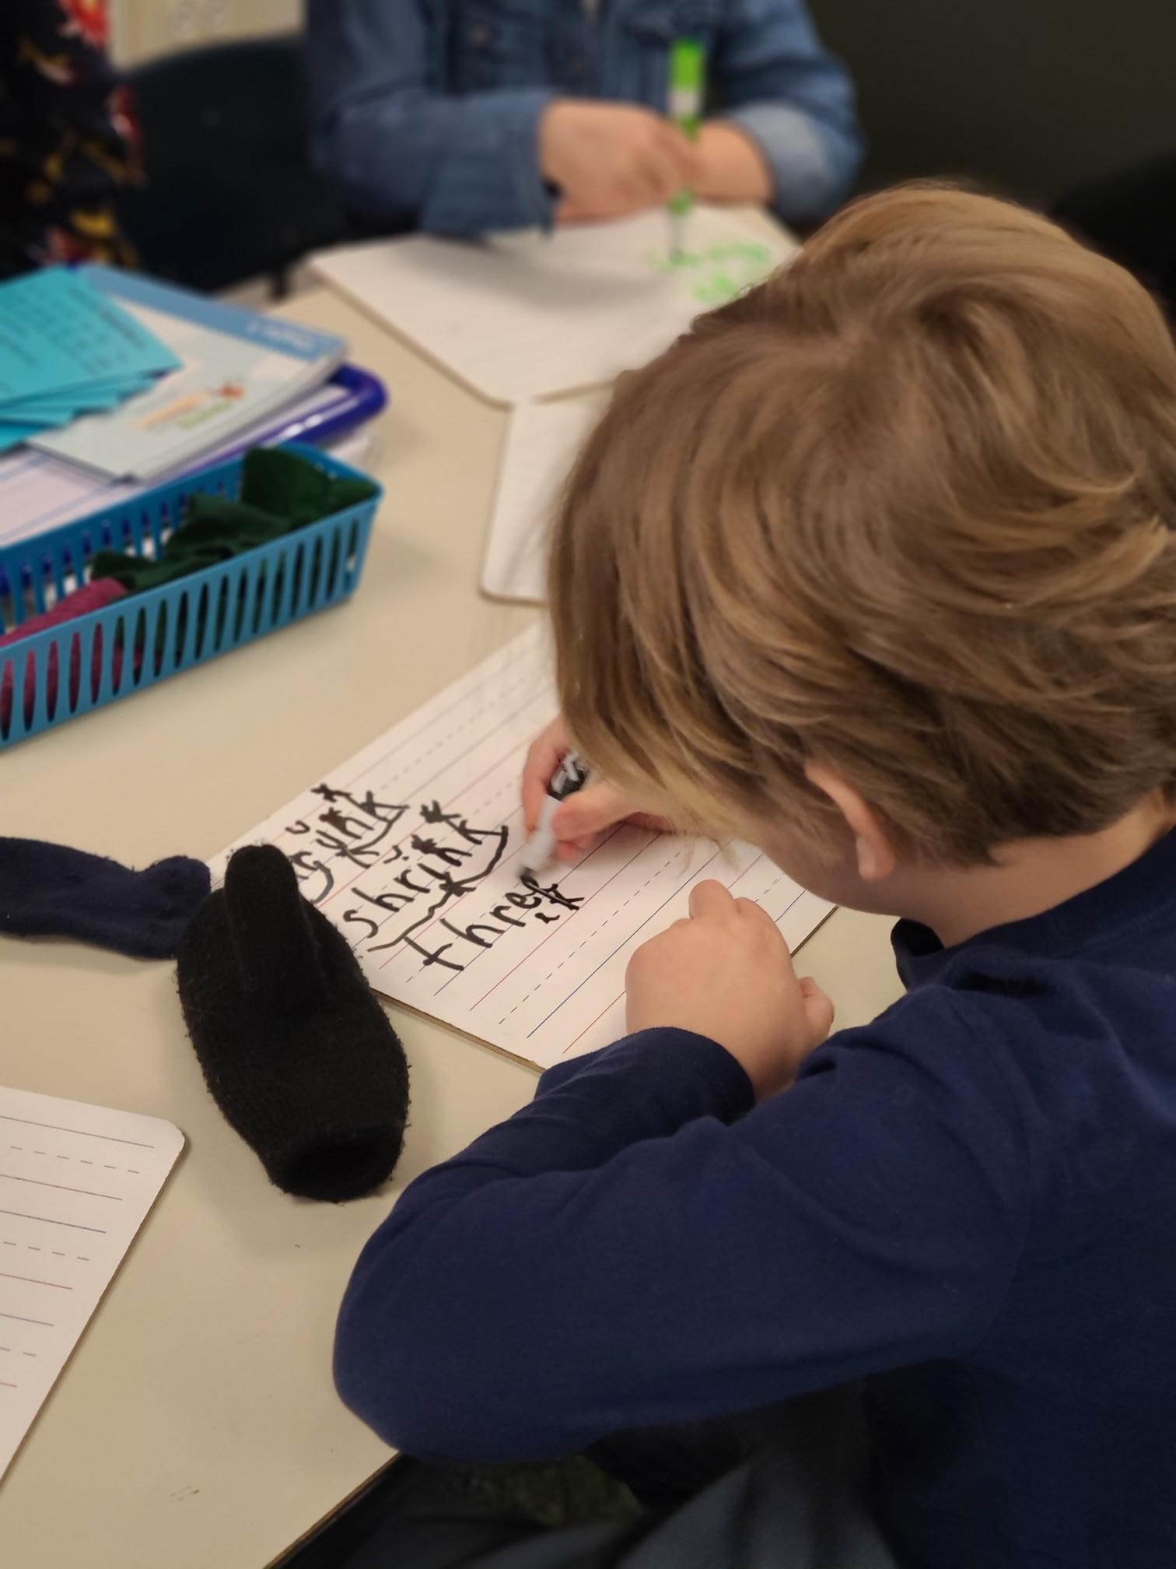
Assessment Process
Your child will take multiple assessments throughout the year including our new Star Assessment in Reading and Math.
The MTSS building team works together to review data for all students.
Families will be notified if extra support or enrichment is needed.

Slide 20
Specials
Quest, Mr. Shaw
Music, Mrs. Simon
Art, Mrs. Noone
Phys. Ed., Mr. Foster
Library, Mrs. Thomas

Slide 21
Communication
Email Updates, Gayman Gazette
Seesaw work
Contact me:
  Call Gayman
    (267) 893 – 4350, x 1430
  E-mail me:
    gflanagan@cbsd.org

Slide 22
Extras
Physicals/Dentals - 3rd grade dental forms by Oct. 15
Remember to complete your registration paperwork in Infinite Campus
Laptop distribution tomorrow!
Please be sure you paid the $15 fee in My Payments Plus
I will send username and password home
Charge each night
www.cbsd.org/1to12022
Breakfast costs $1.65 and lunch costs $2.60; MySchoolBucks

Slide 23
Questions?
Feel free to leave any questions for me on an index card and leave on your child’s desk.
Don’t forget to write back to your child!

